Slide 1
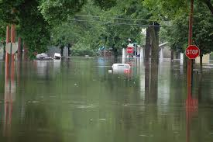
Neighborhood Emergency Radio
Part of the Open Radio Curriculum Project

Slide 2
Welcome & Introductions
No need for any radio experience.
No need to take notes – our handout has all this info in it!
Trainer intros
Introduce yourself to someone you’re sitting next to with:
  Your name and one reason you’re interested in radio…
  …Or one question you have

Slide 3
Disclaimer
We’ve necessarily simplified some information here.
  There are exceptions to a lot of the things we mention.
  But what we say will be precise enough to help you understand radio communications and get you started on your radio journey!
  Feel free to ask us clarifying questions at any time.

Slide 4
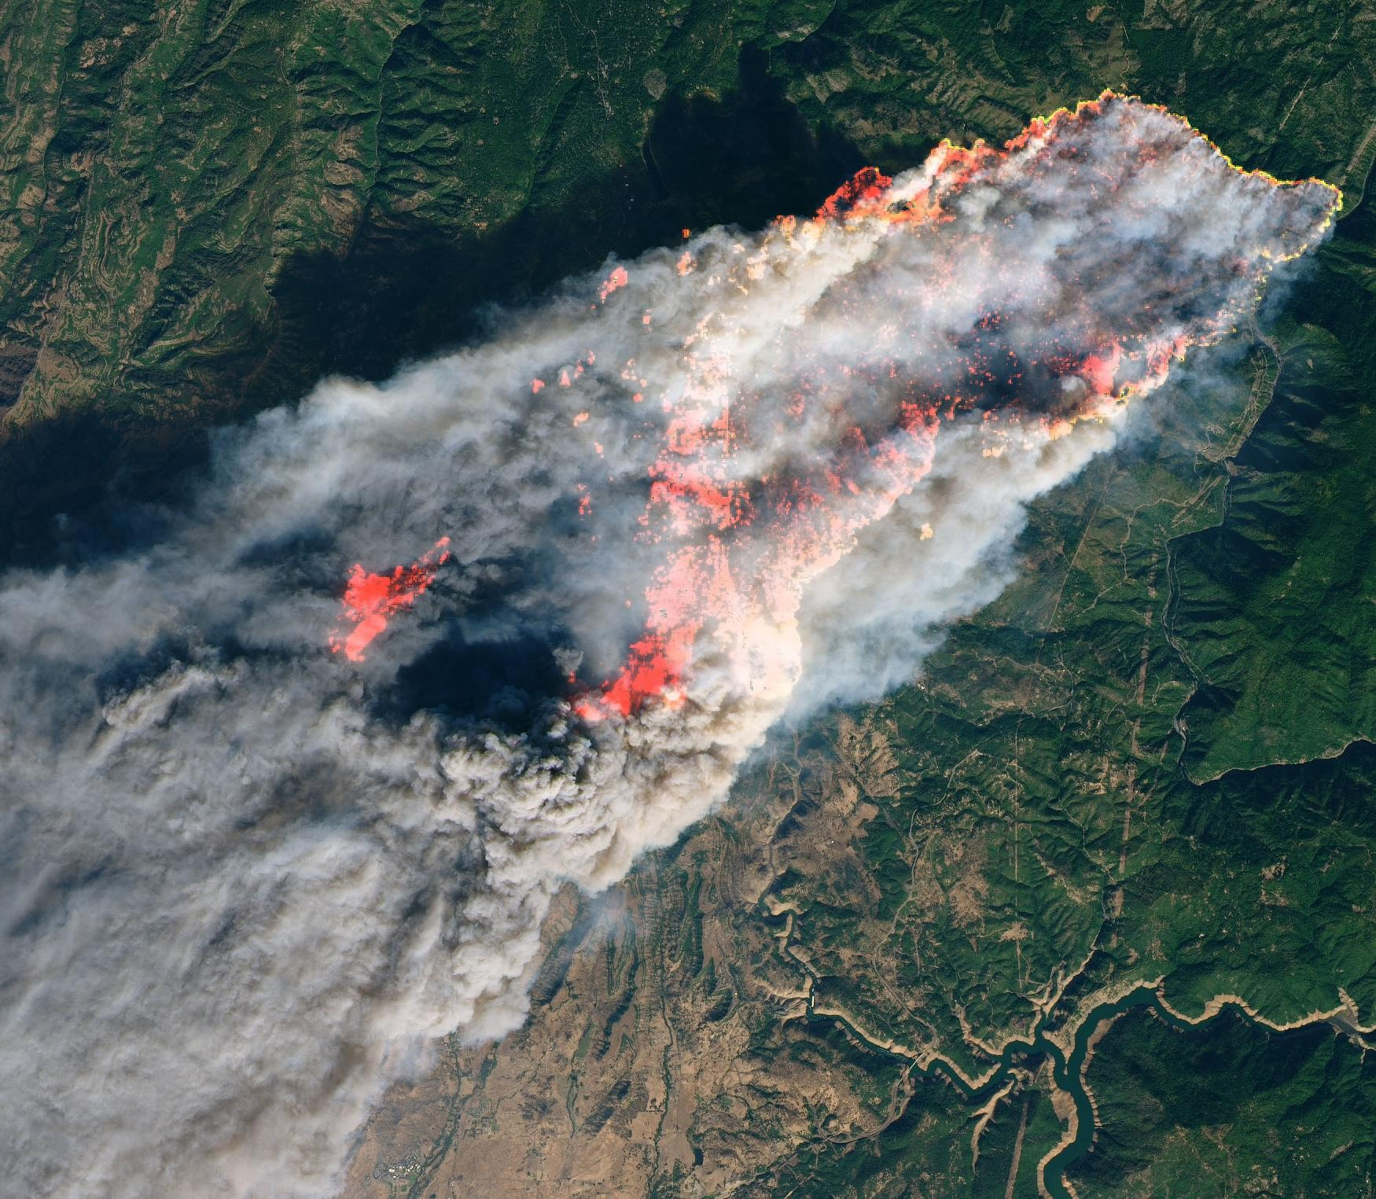
When Infrastructure Fails
Camp Fire in 2018:
  Early warning system failed.
  85 people killed in the town of Paradise, CA.
  17 cell towers burned down on the first day.
  66 cell towers were damaged or out by end.
Cell infra depends on electricity and fiber. (both impacted by wildfires)
Although many comms were out, radio still worked.
20+ Hams helped with comms support for rescue efforts via ARES.
Notes:
Hams provided comms support for the Red Cross Disaster Operations Center (DOC), Cal Office of Emergency Services, and mountain shelters.
References:
https://www.arrl.org/news/amateur-radio-volunteers-at-the-ready-for-california-fire-duty
https://www.eham.net/article/42234
https://arrleb.org/index.php/speaker/show_speaker/35 (see links)

Slide 5
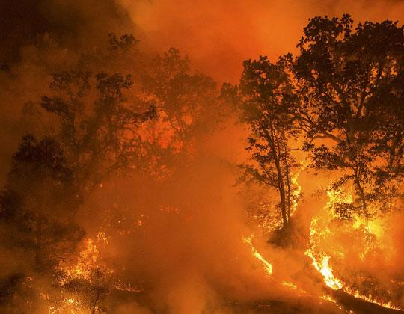
Questions for Comms Planning
To communicate with your friends, family and community during a disaster, you need a plan.
What disasters/emergencies do you anticipate?
Who will you want to communicate with?
What information will you need to transmit? What will you want to receive?
Over how much distance will you need to communicate?
What technologies will you have available to use?
Notes:
Try to draw out as many answers as possible:
People probably don’t just want to talk to immediate family members, but potentially older parents or grown children with their own families, etc.
For distance, people probably want to reach people in the same city or county, but probably in the next big city or town over, where they may commute to work every day.

Slide 6
What are Radio Waves?
The electromagnetic spectrum is the full range of electromagnetic radiation, from radio waves to visible light and more.
One way to measure electromagnetic waves is by how frequently the wavelength goes from peak to peak in one second.
That measurement is the frequency, and the unit for it is Hertz (Hz).
  So “5G” WiFi operates on the 5 gigahertz frequency.
  5G WiFi waves go peak to peak 5 billion times a second.
Electromagnetic radiation is stopped by metal, concrete and dirt.
Notes:
If people look confused or intimidated, you can warn them that this is the most technical slide in the presentation.
Having said that, there’s usually one person who really needs a slightly deeper dive into the science, and this slide is for them.

Slide 7
Frequencies vs. Channels
The electromagnetic spectrum is divided up by the gov’t for different uses – e.g. 5 gigahertz is reserved for WiFi.
Radio transceivers transmit on specific frequencies reserved for radios.
A “channel” is a specific, narrow slice of the spectrum.
Old school broadcast TV had 35 channels allocated, 6 MHz each.
GMRS is restricted to 22 specific channels. Speaking of which…
Notes:
If anyone asks, GMRS channels are either 12.5kHz or 25kHz. Ham UHF/VHF is usually 10kHz or 15kHz.

Slide 8
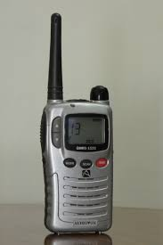
GMRS Overview
We recommend GMRS radios for basically everyone.
They have a 1 to 5+ mile range, can be sturdy and easy to use
These start from about $36 a piece. Cheap!
You might find “FRS” radios for a bit cheaper.
We recommend against FRS, as they are lower powered, lower quality and have fewer features.

Slide 9
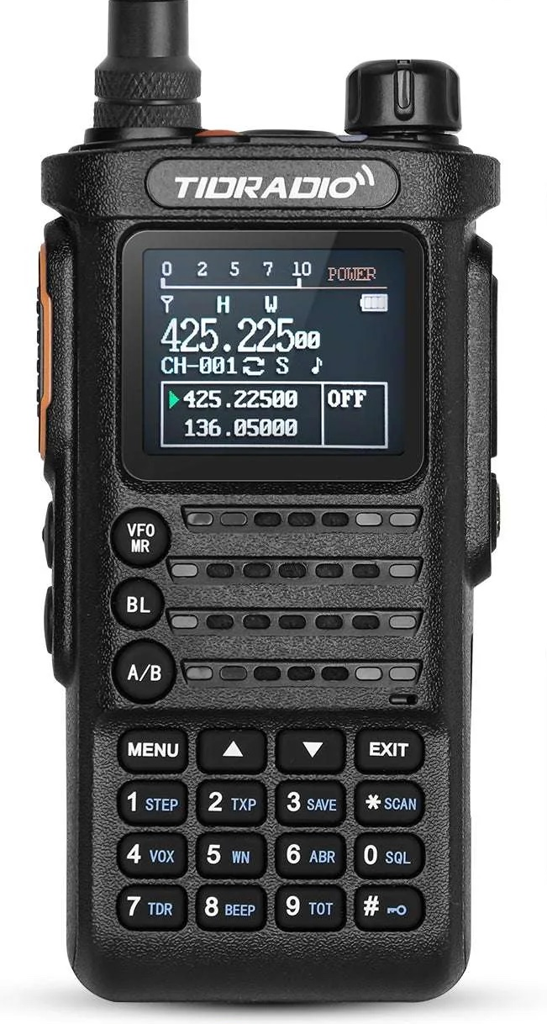
Buying Your First GMRS HT
GMRS is often part of the plan for local emergency services.
GMRS requires a $35 license, but there’s no test, and it covers your whole family.
Unscientifically, 99% of GMRS users don’t have a license.
But here’s why you still might want one.
A decent GMRS radio will let you use repeaters with some light “programming”.
Repeaters can give you much more range.
But no one will talk to you on a repeater without a license.
We’ll cover repeaters more in a bit!

Slide 10
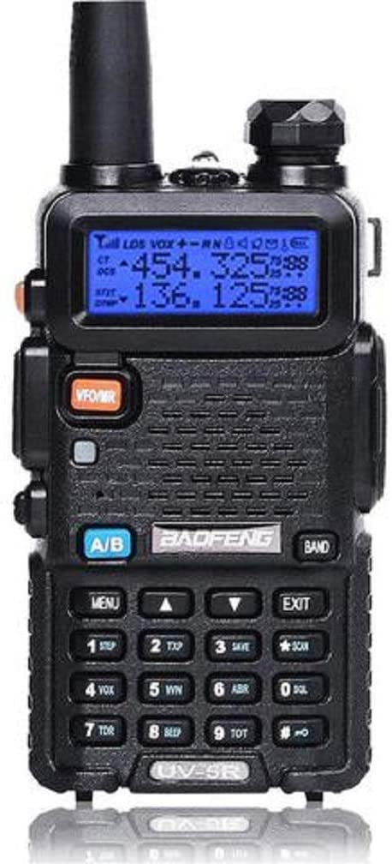
Ham (Amateur Radio) Overview
The next step up from GMRS is Ham “HT” radios.
HT stands for “handheld transceiver”. (vs. ones that go on your desk, or in your vehicle)
Ham radios can operate on wider parts of the radio spectrum.
  Ham radios can select from hundreds of frequencies – vs. just 22 for GMRS.
The classic “good enough” first Ham HT is the BaoFeng.
  BaoFengs start at $20, a good antenna is another $20.
  A good Ham HT starts around $100, great ones $400.

Slide 11
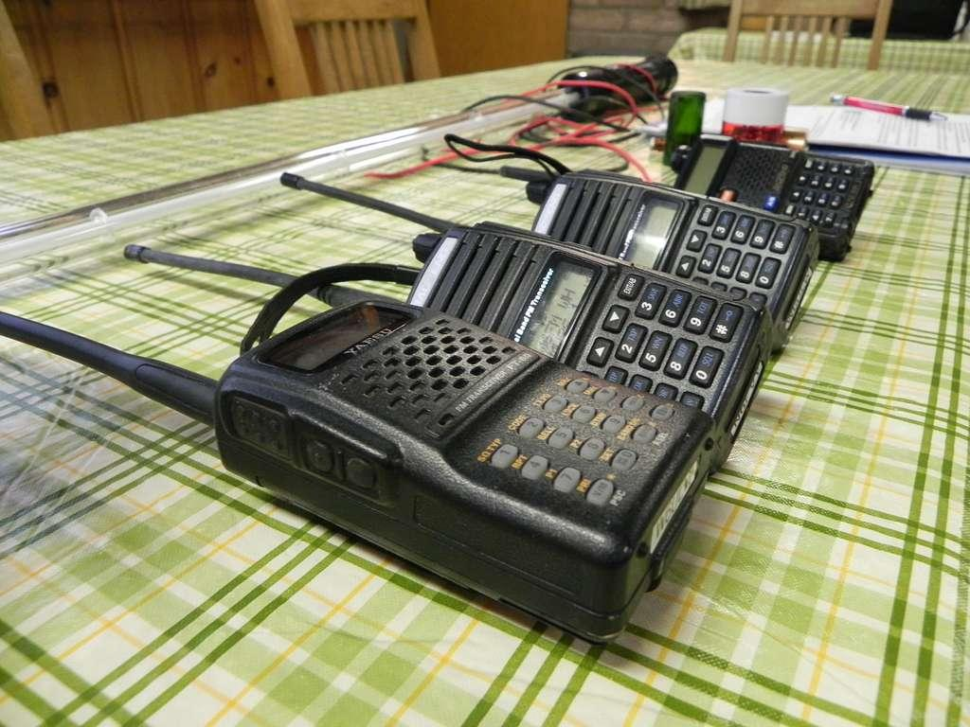
Emergency Radio Considerations
Features you may want in an emergency radio:
Cheap(er)
USB-C charging
Water resistance
Availability of extra batteries
Ease of use
What might you practice with your radio before an emergency?
Notes:
What to practice:
* Programming frequencies into a Ham radio * Scanning channels (GMRS) or frequencies (Ham)
* Talking to people * Hitting repeaters * Reaching specific individuals

Slide 12
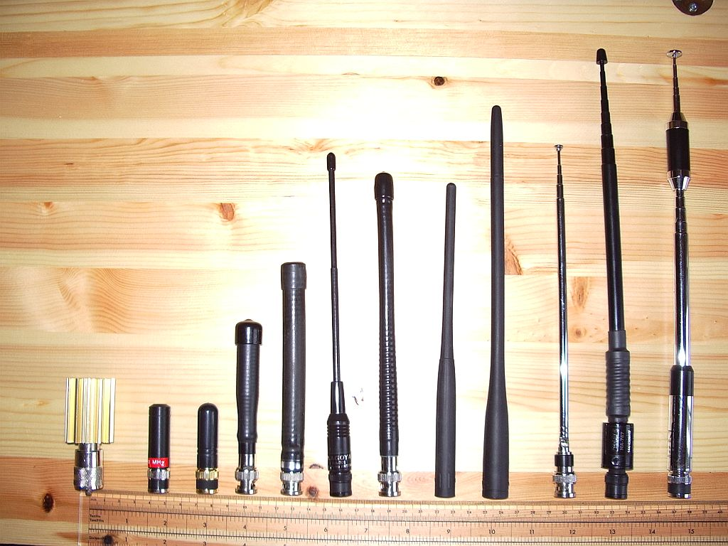
Get More Range (With any Radio)
Radios primarily operate by “line of sight”.
Being high up gives you more range. (“Height is might.”)
Decent radios also let you swap out their stock antennas for better ones.
  This is most important for range after clear line of sight and height.
This is more important than having a lot of watts of transmitting power.
Finally, if you can’t reach someone, try moving yourself.
  You may make contact from a different floor or even room of your home, or from the front yard instead of the backyard, or at the top of a nearby hill.
Notes:
This is the place to explain how line of sight works with radios.
I am deliberately not mentioning atmospheric propagation here. (This goes with the disclaimer at the beginning that this presentation is simplified!)

Slide 13
How Will You Coordinate Your Comms?
With radio, the people you want to talk to must be listening on the same channel or frequency you transmit on.
Agree on regular call times so that you can reach each other:
  i.e. “I’ll transmit for three minutes on channel 3 at the beginning of every hour.”
Choose a default channel or frequency and backups to communicate on.
  This could be as simple as “Try the local repeater, and then X frequency, and then Y.”
  Speaking of repeaters…
There are also standard “calling frequencies” which many users regularly monitor.
We have a PACE activity for planning emergency comms with your people.
Notes:
If people ask, you can mention the calling frequencies for UHF and VHF amateur radio.
Some cities or counties also have GMRS calling channels for emergencies. (i.e. channel 22)

Slide 14
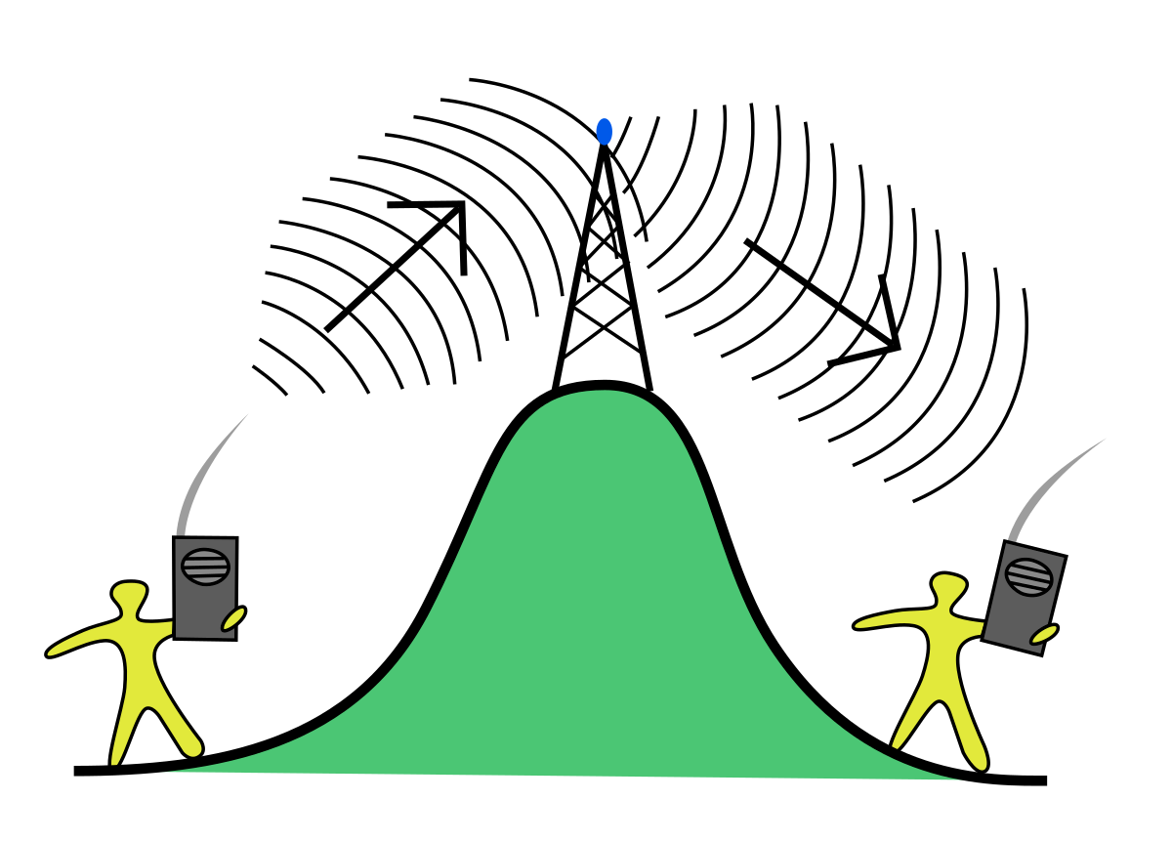
Repeaters
…are radios in a box that receive on one frequency and automatically re-transmit on another.
They are often placed on mountain tops or tall buildings.
  Repeaters can get your transmissions over skyscrapers and mountains.
  This gives them (and you) clear line of sight for up to 50+ miles of range!
Practically every city has at least one repeater.
  Some light radio “programming” is required to transmit to them and hear them.
They exist for both Ham and GMRS radios.
Notes:
To not overwhelm participants, there’s a lot I’m deliberately omitting here, like control tones.
Mention that online repeater lists can be inaccurate, and the only way to know is to test yourself. This is why practice is important!

Slide 15
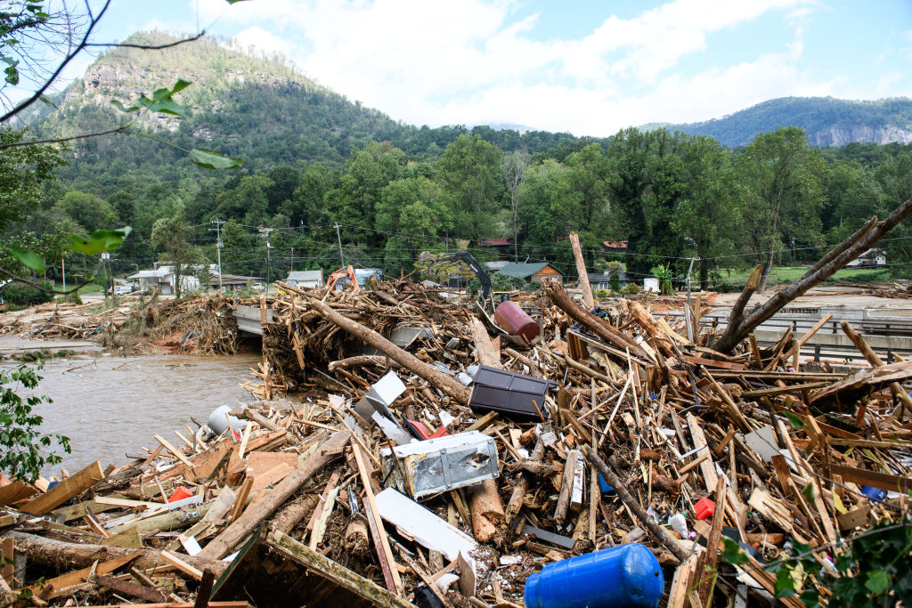
North Carolina Post-Helene
“Mayor of Canton Zeb Smathers referred to recovery efforts as being for a ‘21st century storm with 20th century technology’ due to telecommunication and power outages forcing first responders to use pack mules and handwritten notes for communication and delivery. Black Mountain residents resorted to using makeshift message boards to list missing residents and humanitarian aid details.” – Wikipedia
Some folks lacked cell phone and internet for weeks after the hurricane.
Ham radio filled the gap.
There was a single, 5-watt (small!) repeater at the top of the mountain, where it covered basically the whole mountain and valley below it.
People used Ham radio to check in on elderly family, share info about what resources were available, and give up-to-the-minute road conditions.

Slide 16
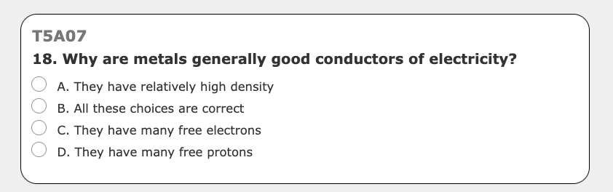
Ham Licenses
Under normal conditions, no one will talk to you on a repeater without a call sign – your unique ID – which you get with your license.
The first is a Ham license is a Technician license.
The “tech” exam has 35 multiple-choice questions out of a pool of 412.
  Pass with 74% (26 questions) right.
You pay ~$10 to take it online, $35 for your license if you pass.
  You get a 10-year license and a random call sign.
Notes:
If anyone asks, this $35 fee is in addition to the $35 fee you may have already paid for a GMRS license.
The picture in the top right is a real question from the current Ham radio exam pool.

Slide 17
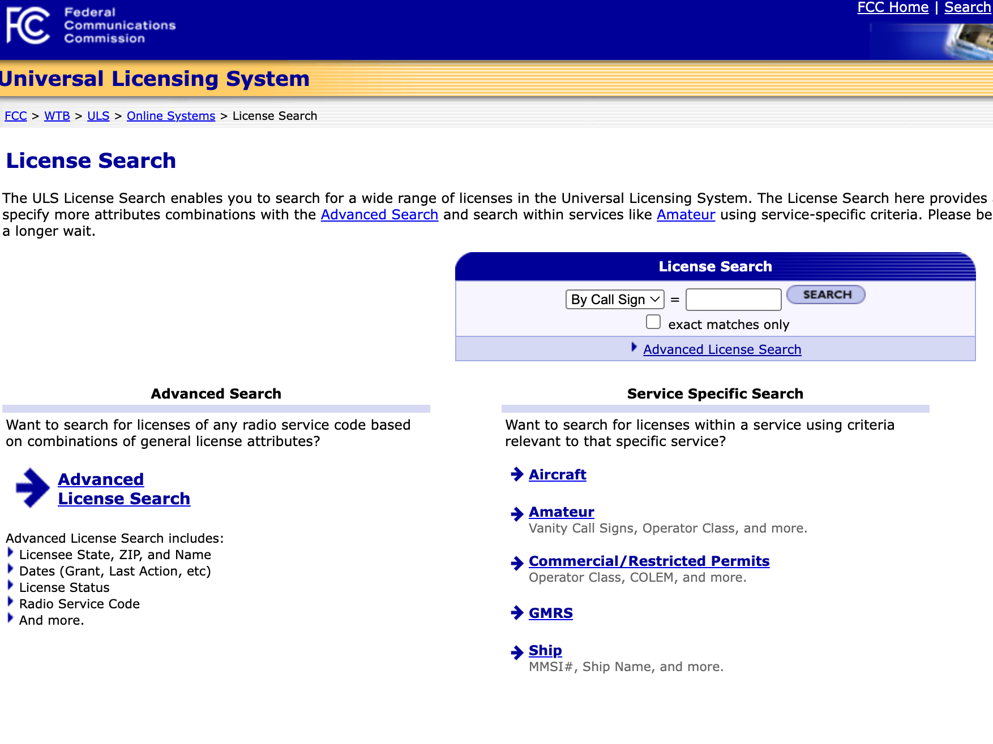
More Licensing Considerations (Ham & GMRS)
You have to give the FCC your legal name.
Call sign is public searchable and ID’s you.
Your address is visible online via your callsign — you can use a PO Box or community center, etc. for privacy.
Do you have a felony conviction?
  You have to include a written explanation…
  But you’ll probably still get a license.
Notes:
Make clear that it is not illegal or even in bad faith to use an alternate mailing address.
The only practical requirement for the address is that the FCC can reach you there – like with a warning or citation!
In practice, most FCC communications with you will happen via email.

Slide 18

Why Get Licensed?
Basic reasons:
It’s the law.
It’s cheap.
It’s fast and easy.
Important reasons to get licensed:
Comms is hard to get right, especially when you’re under pressure.
The only way to learn is by practicing with the greater Ham radio community.
If you don’t have a call sign, no one in the community will talk to you.
Notes:
If people ask, explain that Hams will often look up your callsign when you transmit, so they’ll know if you’re using a fake/made up callsign.

Slide 19
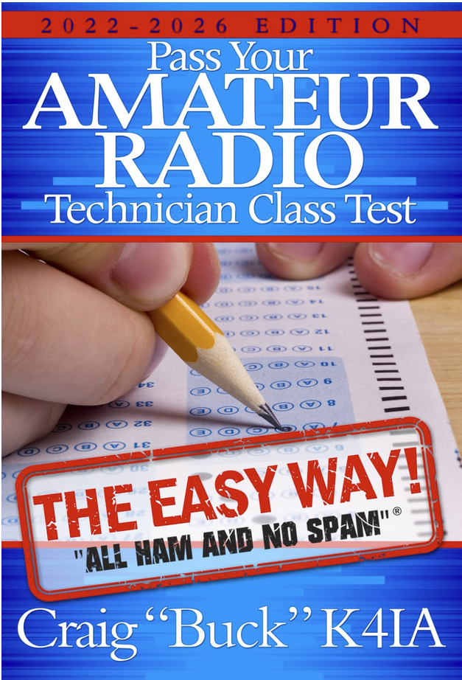
Resources to Study for Your Ham License
www.hamstudy.org
HamStudy phone app
Pass Your Amateur Radio Technician Class Test - The Easy Way
  From the “All Ham and No Spam” series
"Ham Crams" are a very effective way to get your license.
Find your local club to learn more!

Slide 20

Ham Radio DNA
Ham radio was founded on transparency.
Anyone can listen to any Ham at any time.
This is important during disasters.
Note: Anyone can legally (and practically) listen to any radio frequency.
Ham radio is not “broadcast” radio!
Broadcast means “for the general public to listen to”.
Ham is for “Hamateurs” to talk to each other.

Slide 21

What You Can’t Do With Ham
Ham’s DNA explains some of its legal limitations:
Illegal to encrypt transmissions or talk in code.
  There are security-by-obscurity options: Low transmit power, less-used bands…
Illegal to broadcast music – no pirate radio :(
There are also technical limitations:
With some work, someone can find your location when transmitting. (like all radio)
If you talk to someone, everyone else on that frequency can hear you. (unlike a cell phone)

Slide 22
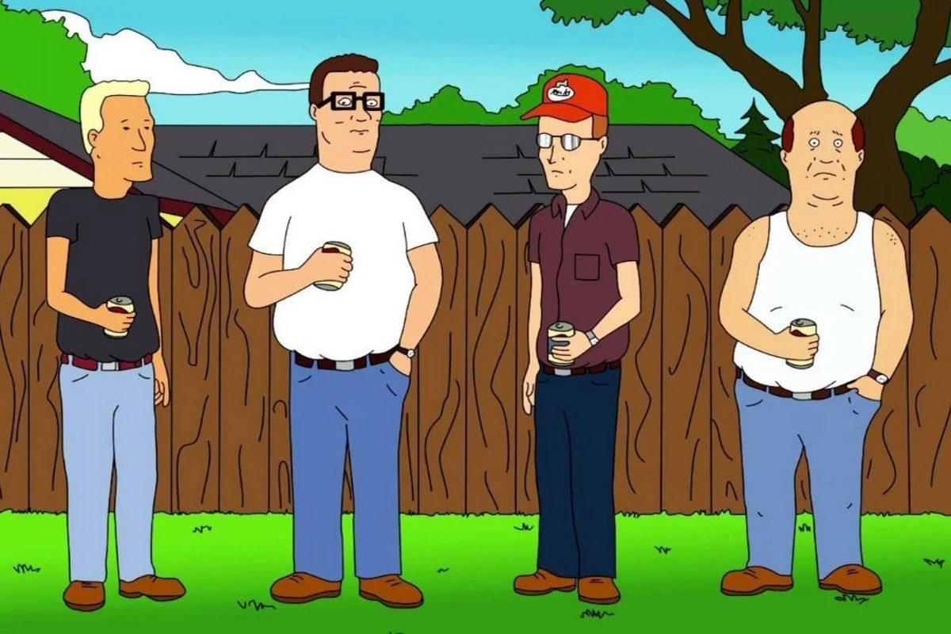
Ham Community, Ham Culture
Ham culture is based on openness and educating future Hams.
  They know they need new people for their beloved hobby to survive!
Ham culture also developed ~100 years ago, when radio was a primary way to make friends and communicate.
  Some older Hams use their local repeater to small talk with friends for hours.
  Other repeaters discourage people from tying it up, because that makes it unusable for others.

Slide 23
Radio Clubs!
Practically every big and medium-sized city has its own radio club.
Clubs host talks, maintain repeaters, have weekly “nets”, do support for events, lead emcomms trainings and more.
Club members usually sell gear to each other first, and for lower prices.
  This is a great way to get cheap(er) gear.
  Some clubs even let you borrow equipment!
Consider joining one to learn more about radio.
Notes:
You can explain nets and emcomms here, time and interest permitting.

Slide 24
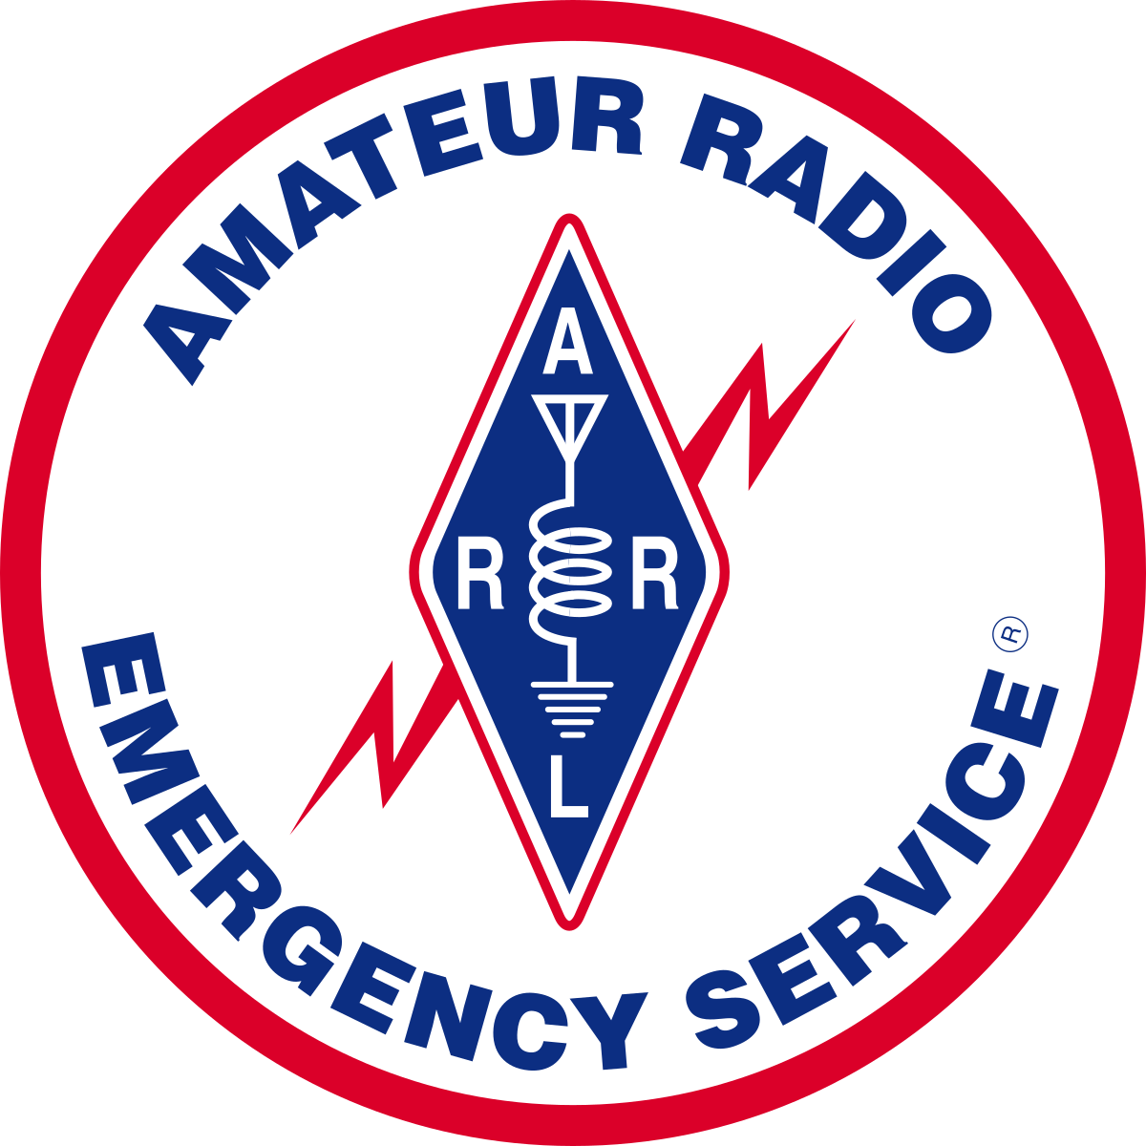
ARES/RACES
Ham radio operators can be an essential part of disaster response. Here are some ways you can get involved:
RACES: Activated by government if they need amateur support – typically only during emergencies.
ARES: ARRL’s emergency comms arm, activated before, during, and after emergencies. Handles a wider range of communications and is organized by Hams, not the government.
Many opportunities to get involved, including through your local radio club.

Slide 25
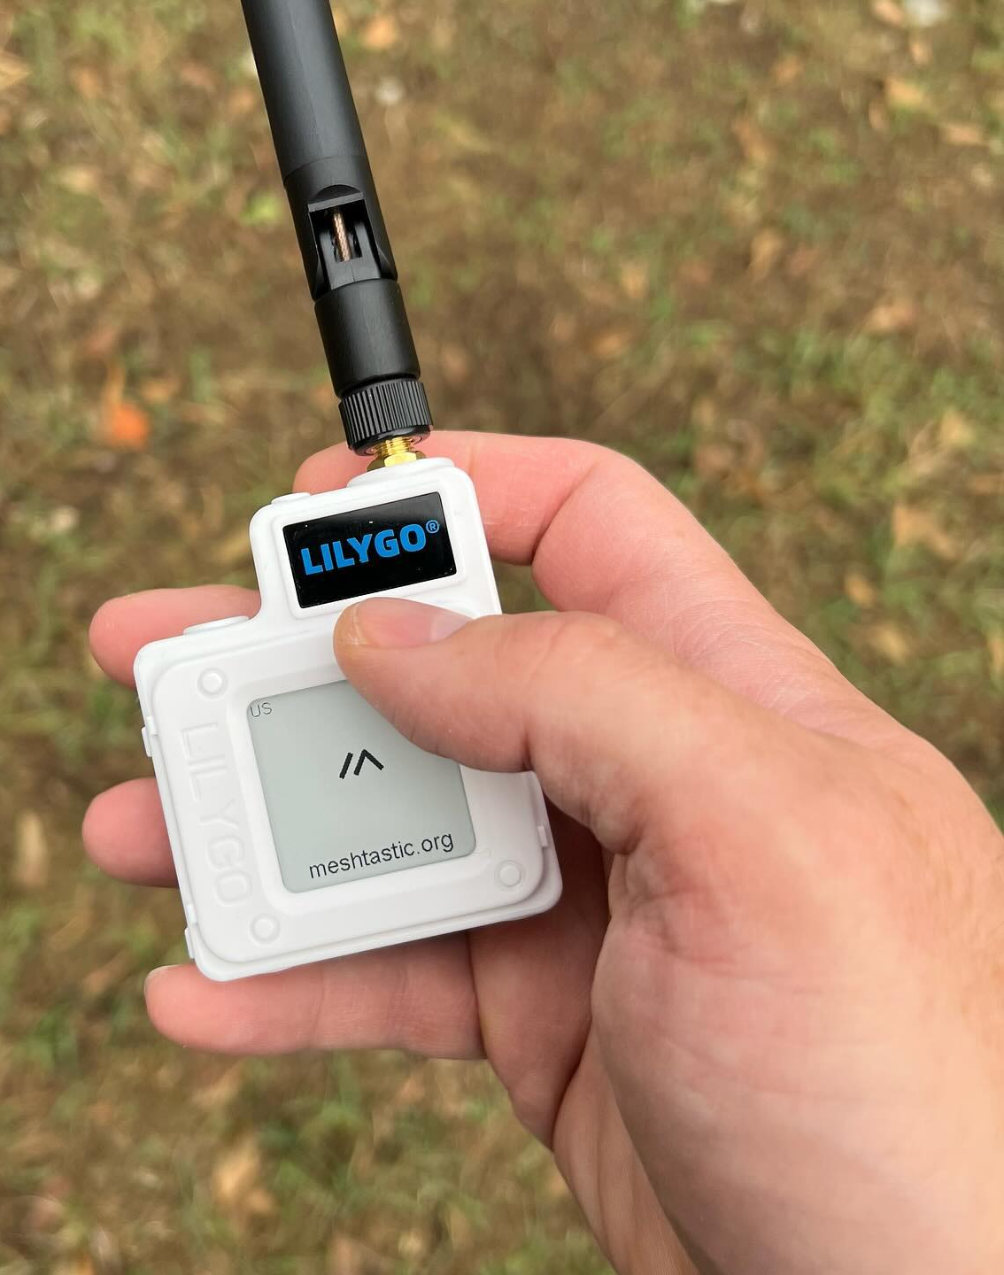
Meshtastic & Meshcore
Meshtastic and Meshcore allow you to send and receive text messages without cell service or internet.
It’s a mesh network. By default, every device re-sends the messages it receives.
  Each message is re-sent up to 3 times in every direction, so they *can* go far under the right circumstances.
  But they are not yet totally reliable for sending or receiving messages.
You will need a compatible device, which is typically $30-$100; cheaper devices require a phone to pair with.
It’s possible to create your own private, encrypted channel.
You can also reach out on public channels.

Slide 26
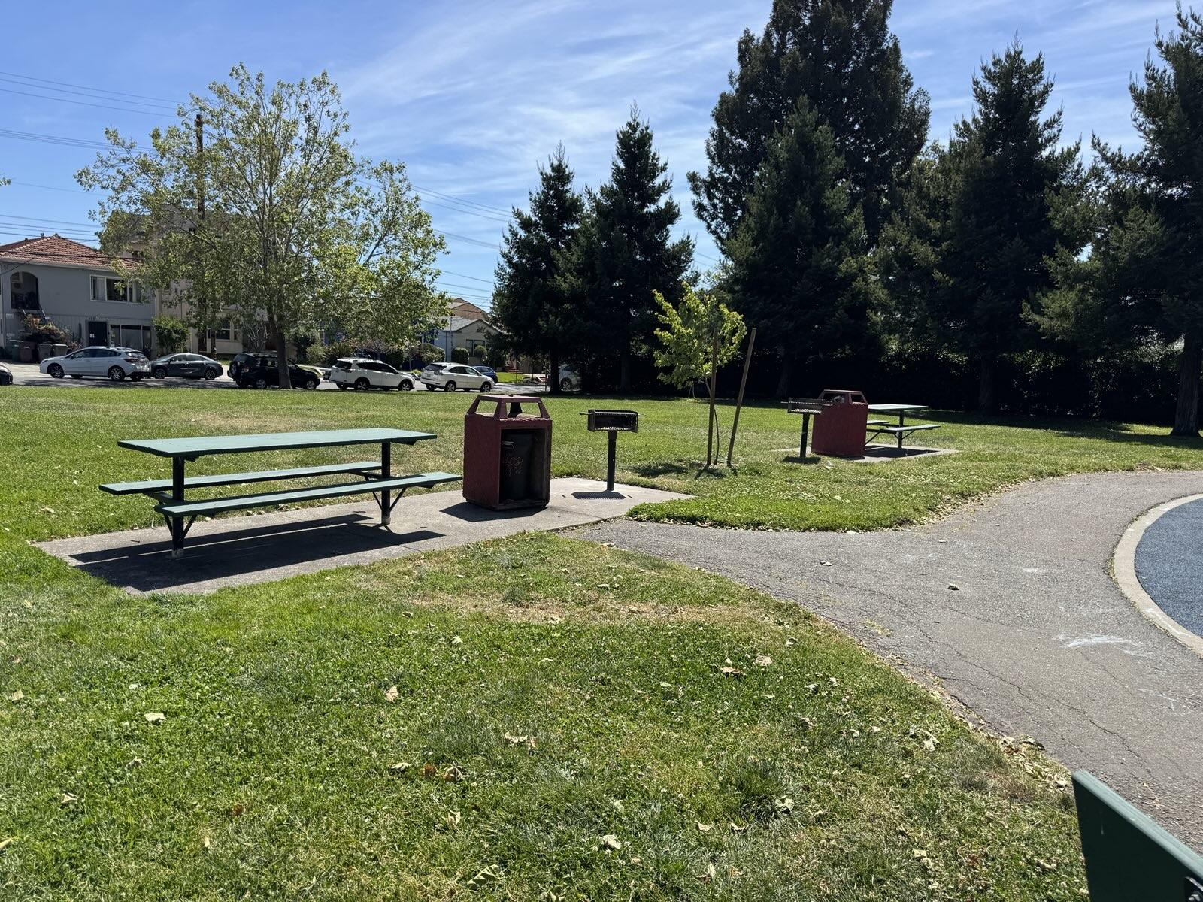
Now Get on the Air!
The best way to learn radio is to practice.
Get your license
Practice with friends in the park
Get on some local nets – or start your own neighborhood net!

Slide 27

Evaluation
This is the most important part for us!
The more candid you are with your feedback, the more we can improve this presentation.
Thank you for participating and we will stay to answer any further questions you may have!

